Slide 1
Computer Architecture 1
Computer Organization and Design T H E H A R D W A R E / S O F T W A R E I N T E R F A C E
[Adapted from Computer Organization and Design, RISC-V Edition, Patterson & Hennessy, © 2018, MK] [Adapted from Great ideas in Computer Architecture (CS 61C) lecture slides, Garcia and Nikolíc, © 2020, UC Berkeley]

Slide 2
What you need to know about this class
Course information
Course Website:
https://sites.google.com/site/kimhuetadtvtbk/cac-mon-giang-day/kien-truc-may-tinh
https://cs61c.org/sp20/#lectures
Nguyễn Đức Minh: minh.nguyenduc1@hust.edu.vn
Textbooks: Average 15 pages of reading/week
Patterson & Hennessy, Computer Organization and Design, RISC-V edition
Kernighan & Ritchie, The C Programming Language 2nd Edition
Barroso & Holzle, The Datacenter as a Computer 3rd

Slide 3
What you need to know about this class
Course Grading
Homework, Assignments, mini-tests(15%)
Project, midterm exam (15%)
Final exam (70%)
Extra Score: EPA!
Effort
Completing all assignments and homework in time
Participation
Asking/Answering Qs in TEAMS/ offline class & making it interactive
Altruism
Helping others in class
Writing software, tutorials that help others learn
EPA! can bump students up to the next grade level

Slide 4
What is expected to this course ?
To explain what’s inside the revolutionary machine, unraveling the software below your program and the hardware under the covers of your computer
To understand the aspects of both the hardware and software that affect program performance
By the time you complete this course, you will be able to answer the following questions:
How are programs written in a high-level language, such as C, Java translated into the language of hardware
How does the hardware execute the resulting program?
What determines the performance of a program?
What techniques can be used by a programmer/hardware designers to improve the performance

Slide 5
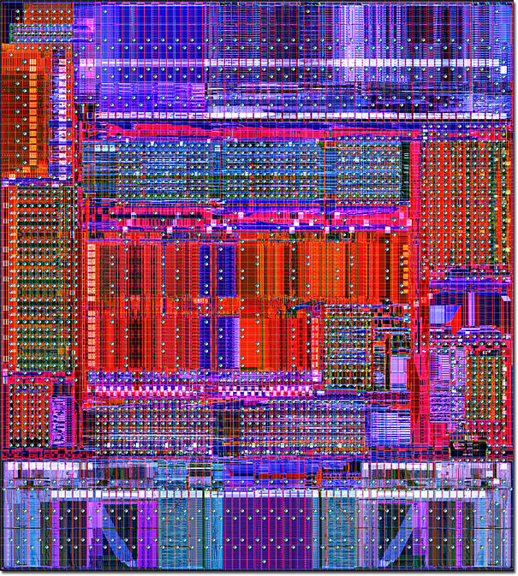
Road map
Chapter 1: Introduction
Chapter 2: ISA MIPS – RISC V
1000
µProc
60%/yr.
(2X/1.5yr)
“Moore’s Law”
CPU
Chapter 3: Single/multicycle Datapath
100
Processor-Memory
Performance Gap: (grows 50% / year)
10
Performance
DRAM
9%/yr.
(2X/10 yrs)
1
DRAM
1980
1981
1982
1983
1984
1985
1986
1987
1988
1989
1990
1991
1992
1993
1994
1995
1996
1997
1998
1999
2000
Time
Course information is described in more detail in the syllabus
Chapter 4: Pipelining
IFetch
Dcd
Exec
Mem
WB
IFetch
Dcd
Exec
Mem
WB
IFetch
Dcd
Exec
Mem
WB
IFetch
Dcd
Exec
Mem
WB
Chapter 5: Memory Systems
Chapter 6: Parallel processor

Slide 6
Introduction to Computer Abstractions and Technology
Introduction
Great Ideas in Computer Architecture

Slide 7
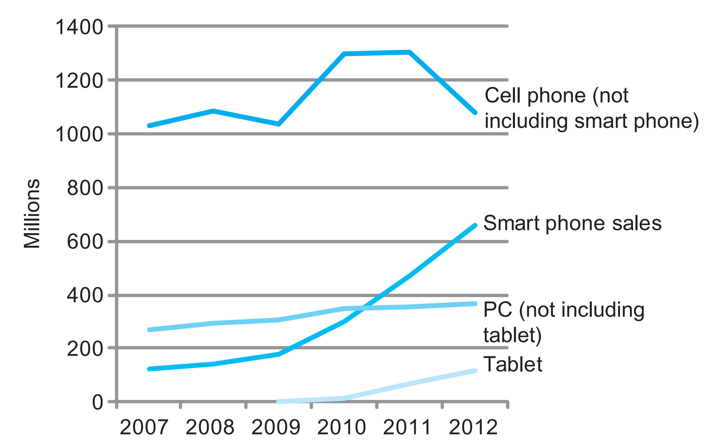
Introduction
Hardware advances have allowed programmers to create wonderfully useful software, which explains why computers are omnipresent
- Computers in automobiles - Cell phones - Human genome project - World Wide Web - Search engines
Smart phones represent the recent growth in the cell phone industry, and they passed PCs in 2011.
Tablets are the fastest growing category, nearly doubling between 2011 and 2012.
Recent PCs and traditional cell phone categories are relatively flat or declining
Notes:
The number manufactured per year of tablets and smart phones, which reflect the post-PC era, versus personal computers and traditional cell phones

Slide 8
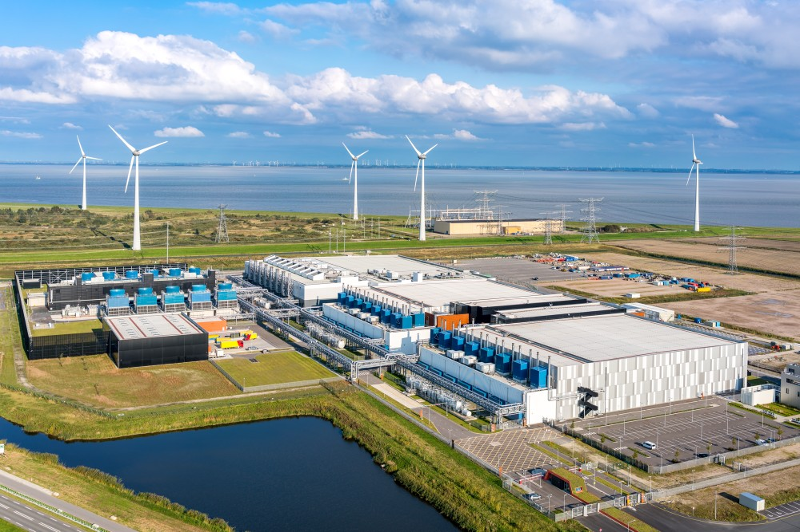

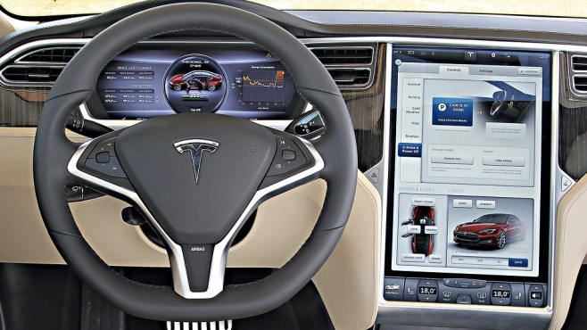
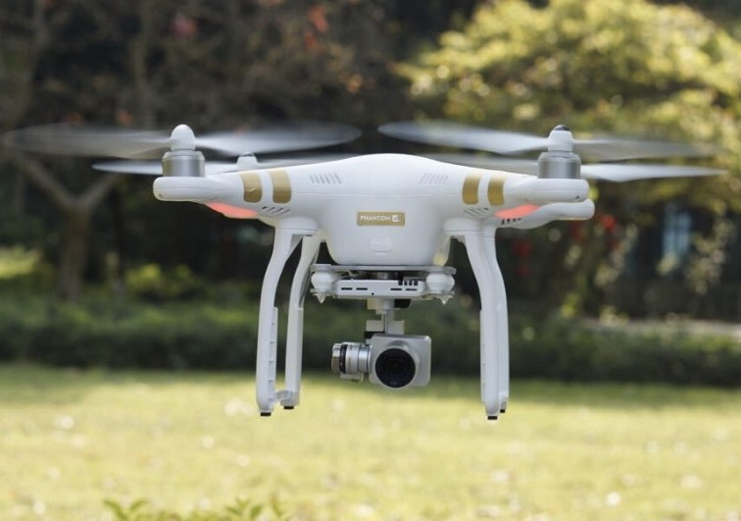

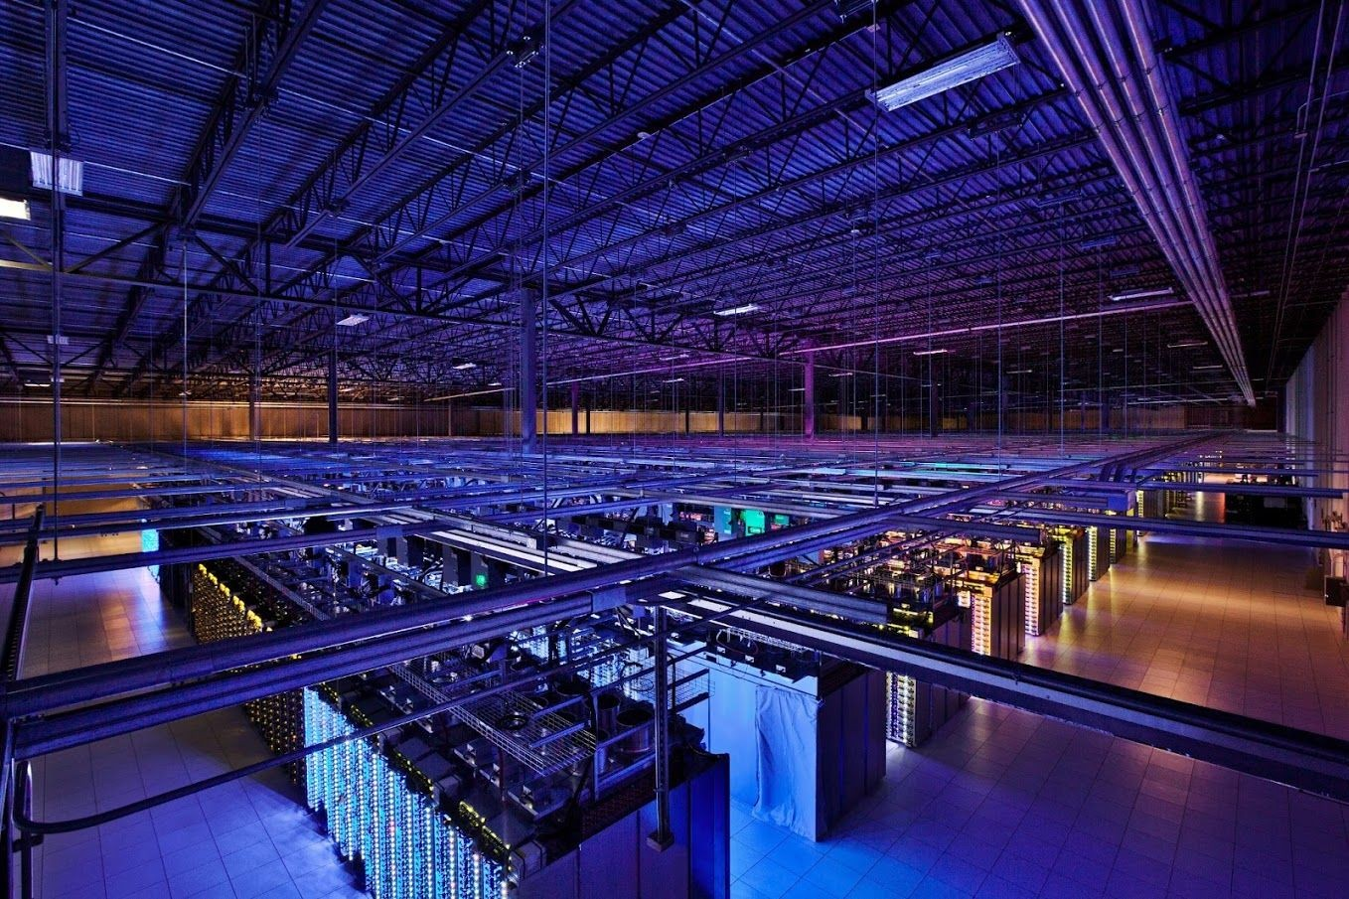
Welcome to the Post-PC Era
Embedded computes in Network Edge Devices
Replacing the PC is the Personal Mobile Devices (PMD)
Taking over from the conventional server is Cloud Computing, which relies upon giant datacenters that are now known as Warehouse Scale Computers (WSCs). Companies like Amazon and Google build these WSCs containing 100,000 servers
Notes:
Today’s PMD is a smart phone or a tablet computer, but tomorrow it may include electronic glasses

Slide 9
Why is Computer Architecture Exciting Today?
Healthcare and wellness
Telemedicine
Education
Autonomous driving
Gaming
Entertainment, VR/ AR
Visualization
Smartphones
Apps
Personal Computers
WWW
Mainframes Scientific computing
Data processing
Software as a Service (SaaS) deployed via the Cloud
1970
1980 1990 2000 2010 2020 2030
Number of deployed devices continues to grow
Diversification of needs, architectures
Machine learning is common for most domains

Slide 10
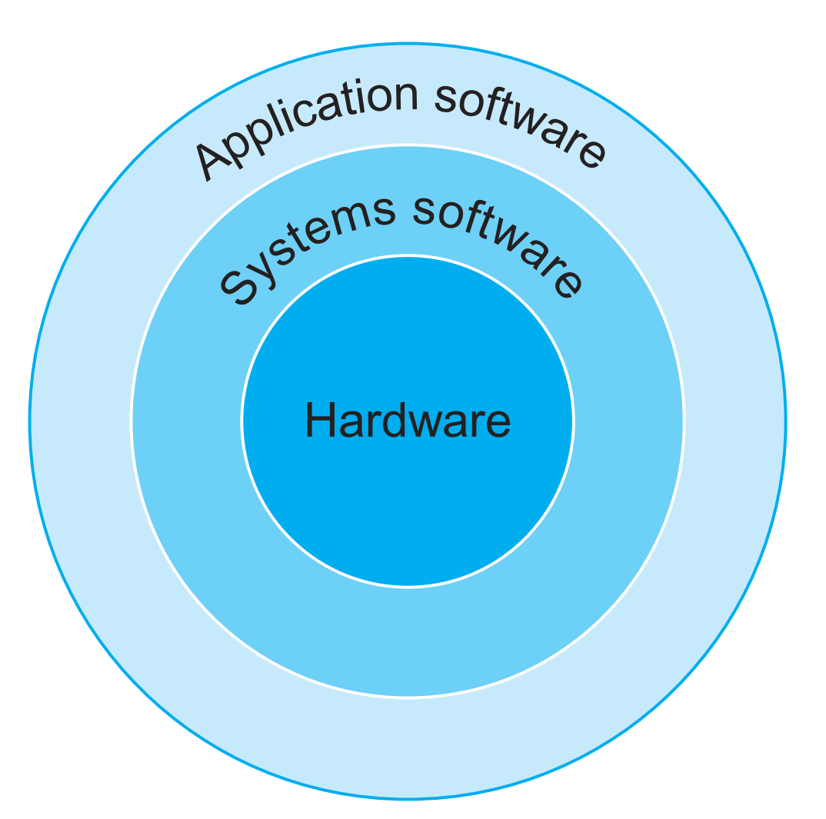
Thinking about machine structure in Computer Architecture 1
Application (ex: browser)
Compiler
Operating System (Mac OSX)
Software
Assembler
Instruction Set Architecture
Hardware
Processor Memory
I/O system
Datapath & Control Digital Design Circuit Design
Transistors
Computers emphasize delivery of good performance to single users at low cost
Fabrication

Slide 11


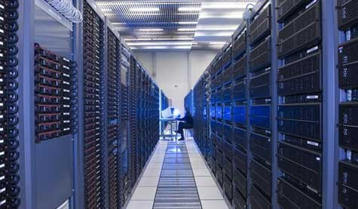

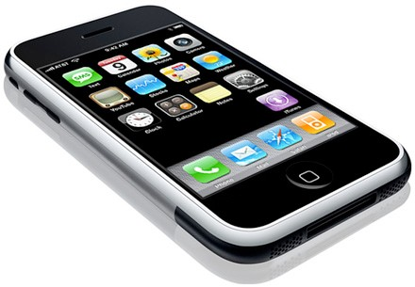


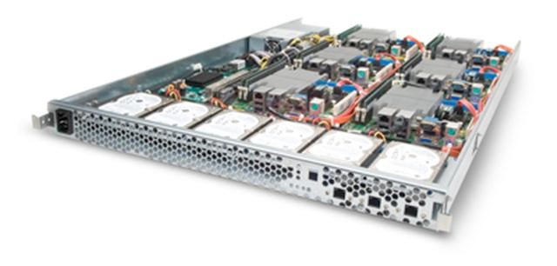




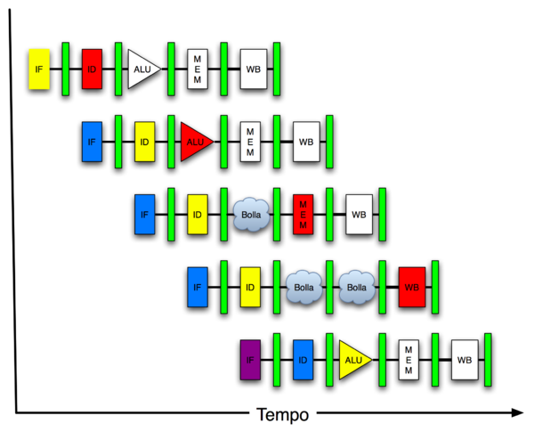

Thinking about machine structure in Advanced Computer Arch – CA 2
Harness Parallelism & achieve high performance
Software
Hardware
Parallel Requests Assigned to computer e.g., Search Cats
Parallel Threads Assigned to core e.g., Lookup, Ads
Parallel Instructions >1 instruction @ one time e.g., 5 pipelined instructions
Parallel Data >1 data item @ one time e.g., Add of 4 pairs of words
Hardware descriptions All gates work in parallel at same time
Smart Phone
Warehouse
Scale Computer
Computer
Core (Cache)
Core Memory
Input/Output
Exec. Unit(s)
Functional Block(s)
A₁+B₁
A₀+B₀
Main Memory
Logic Gates
A B
C
Out = AB+CD
D

Slide 12
6 Great Ideas in Computer Architecture
Abstraction (Layers of Representation/Interpretation)
Moore’s Law
Principle of Locality/Memory Hierarchy
Parallelism
Performance Measurement & Improvement
Dependability via Redundancy

Slide 13




Great Idea #1: Abstraction (Layers of Representation/Interpretation)
High Level Language Program (e.g., C)
temp = v[k] =
v[k+1]
v[k];
v[k+1];
= temp;
Compiler
Anything can be represented
as a number, i.e., data or instructions
lw | x3, | 0(x10)
lw | x4, | 4(x10)
sw | x4, | 0(x10)
sw | x3, | 4(x10)
Assembly Language Program (e.g., RISC-V)
lw | x3, | 0(x10)
lw | x4, | 4(x10)
sw | x4, | 0(x10)
sw | x3, | 4(x10)
Assembler
1000 1101 |  | 1110 | 0010 | 0000 0000 0000 0000
1000 | 1110 | 0001 | 0000 | 0000 | 0000 | 0000 | 0100
1010 | 1110 | 0001 | 0010 | 0000 | 0000 | 0000 | 0000
1010 | 1101 | 1110 | 0010 | 0000 | 0000 | 0000 | 0100
Machine Language Program (RISC-V)
Hardware Architecture Description (e.g., block diagrams)
+4
Reg[]
pc
pc+4
alu
alu ¹
pc
IMEM
^{wb} DataD
1
Reg[rs1]
0
ALU
DMEM
2
pc+4
0
inst[11:7] _{AddrD}
Branch Comp.
Reg[rs2]
Addr
DataR
1
wb
Architecture Implementation
inst[19:15] AddrA DataA inst[24:20] AddrB DataB
0
1
DataW
mem
0
Logic Circuit Description (Circuit Schematic Diagrams)
inst[31:7] _{Imm.}
Gen
imm [31:0]
A
B
Out = AB+CD
C
D

Slide 14
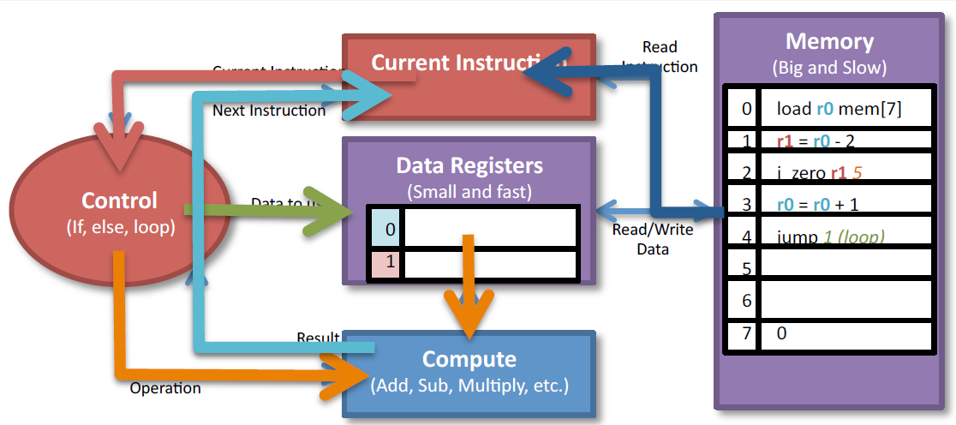
Below your program: Let’s walk through the program
What will the processor do?
– 1. Load the instruction
– 2. Figure out what operation to do
– 3. Figure out what data to use
– 4. Do the computation
– 5. Figure out next instruction
Repeat this over and over and over…

Slide 15
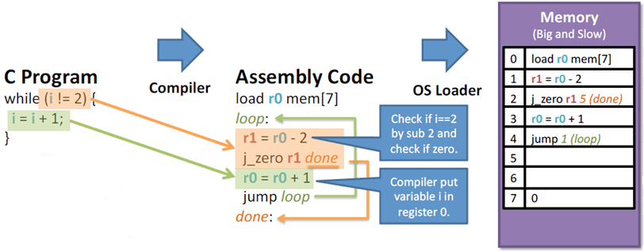
Example

Slide 16
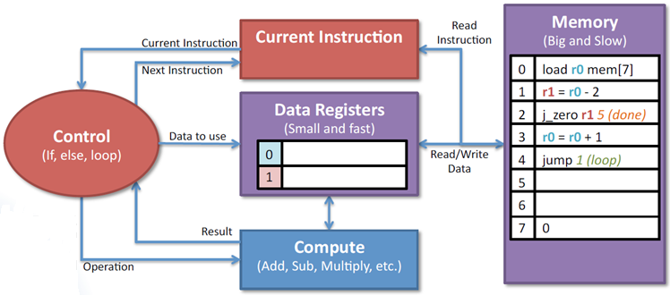
Basic processor: Memory, Control, and Compute

Slide 17
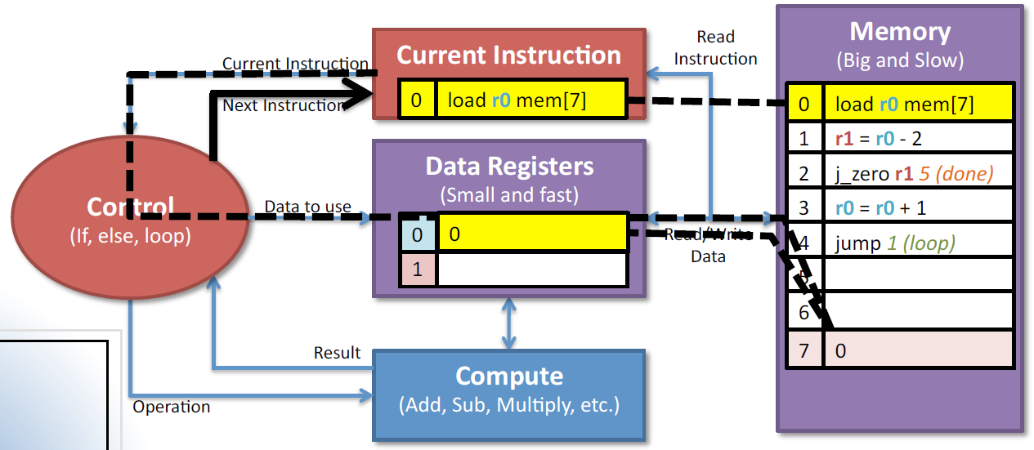
1: Load r0 (i) from memory (location 7)

Slide 18
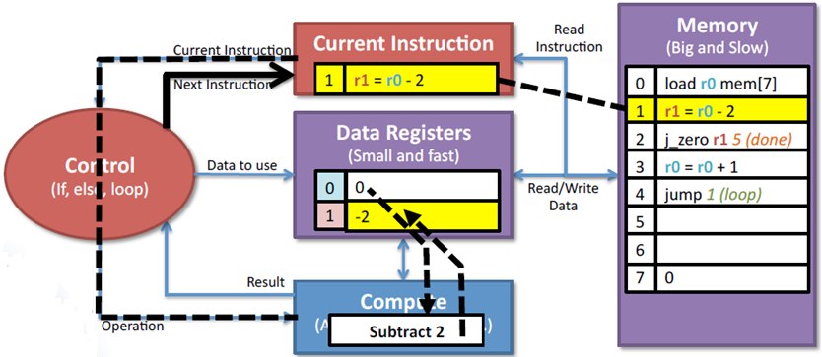
2: Subtract 2 from r0(i) to see if it is 2

Slide 19
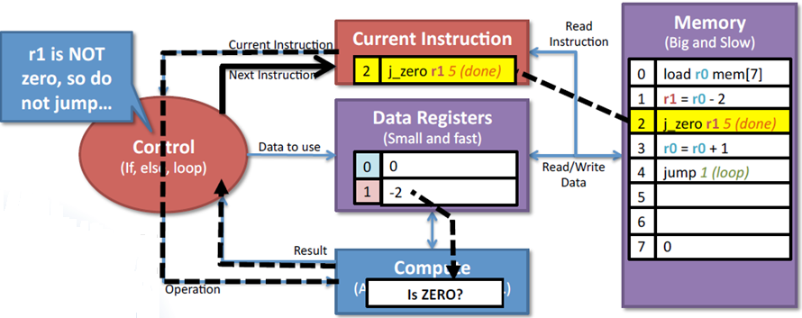
3: Check if r1 is zero 0, and jump to done if it is

Slide 20
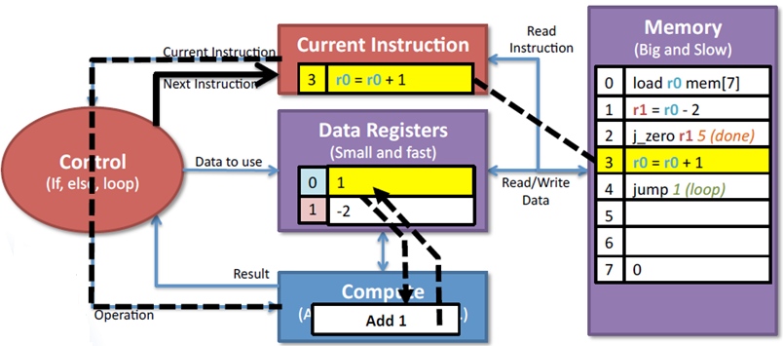
4: Increment r0 (i)

Slide 21
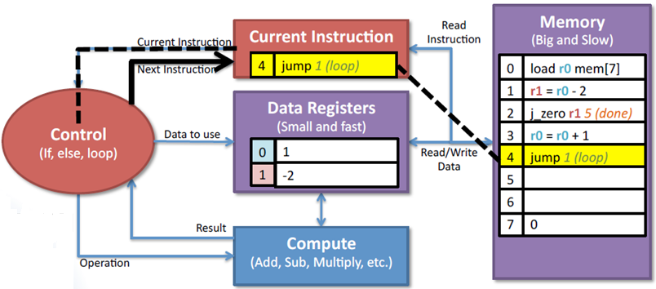
5: Continue the loop

Slide 22
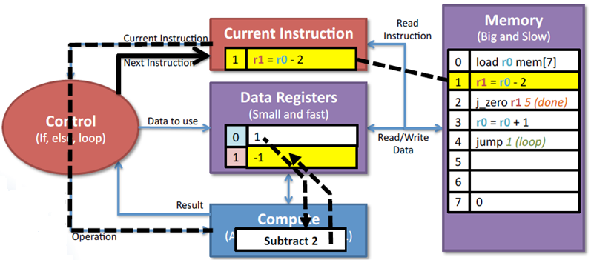
6: Subtract 2 from r0(i) to see if it is 2

Slide 23
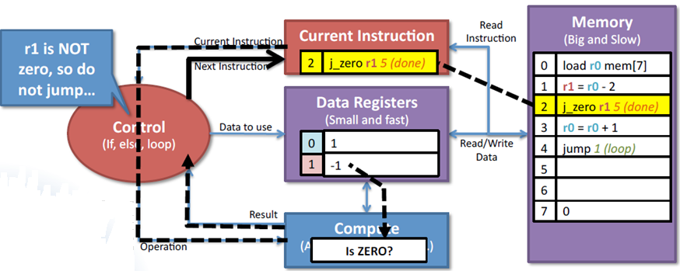
7: Check if r1 is zero 0, and jump to done if it is

Slide 24
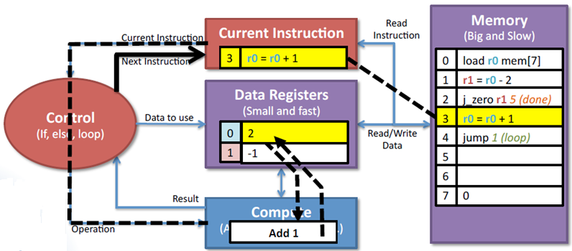
8: Increment r0 (i)

Slide 25
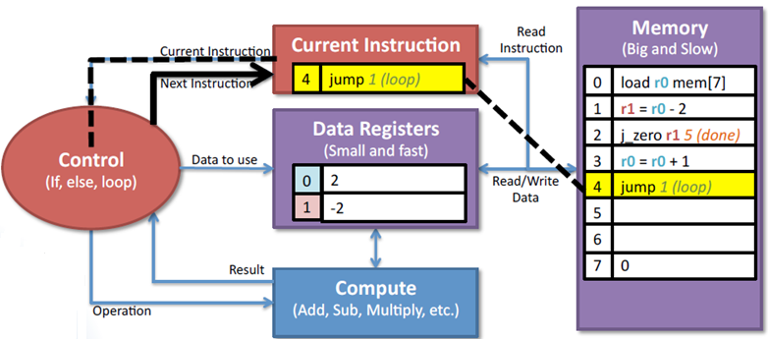
9: Continue the loop

Slide 26
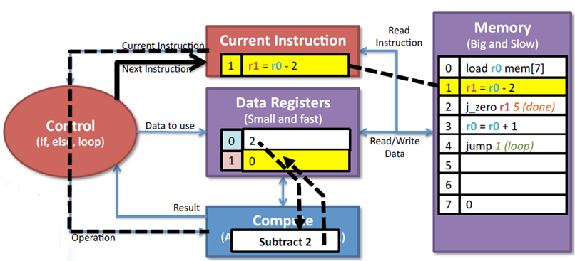
10: Subtract 2 from r0(i) to see if it is 2

Slide 27
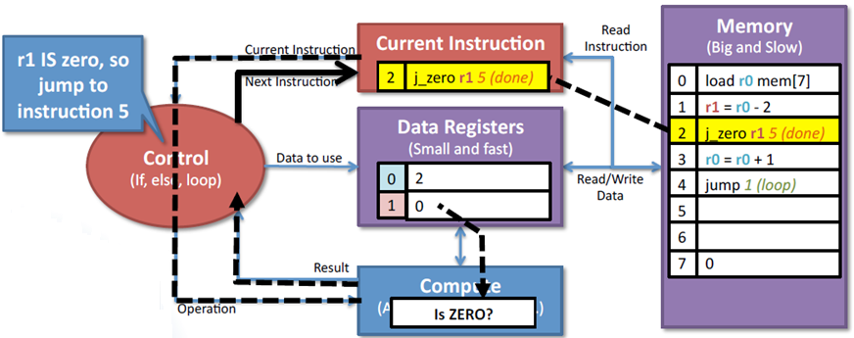
11: Check if r1 is zero 0, and jump to done if it is

Slide 28
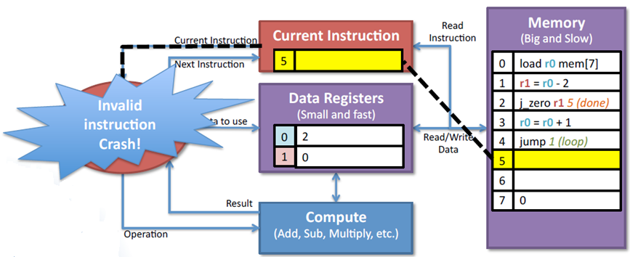
12: Crash because the instruction 5 is invalid!

Slide 29
This course is about understanding the details, corner cases, performance, and how this all comes together in a RISC V processor.

Slide 30
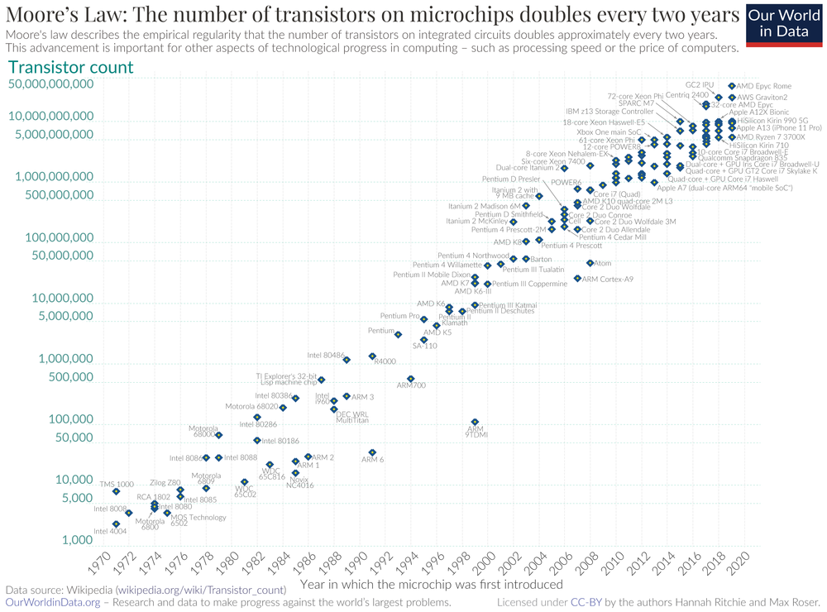

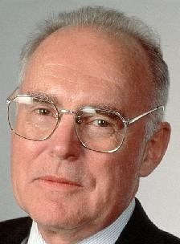
Great Idea #2: Moore’s Law
It states that integrated circuit resources double every 18–24 months
Reduced cost is one of the big attractions of integrated electronics, and the cost advantage continues to increase as the technology evolves toward the production of larger and larger circuit functions on a single semiconductor
substrate.
Electronics, Volume 38,
Number 8, April 19, 1965
Gordon Moore Intel Cofounder
B.S. Cal 1950!

Slide 31










Great Idea #3 : Principle of Locality/Memory Hierarchy
Processor chip
CPU
Core
Extremely fast Extremely expensive
Tiny capacity
Registers
CPU Cache Level 1(L1) Cache
Level 2 (L2) Cache
Faster Expensive Small capacity
Level 3 (L3) Cache
DRAM chip DDR3/4/5 HBM/HBM2/3
e.g.
Fast Priced reasonably Medium capacity
Physical Memory
Random-Access Memory (RAM)
Virtual Memory
Fast Cheap
SSD, HDD
Drives
Solid-State Memory (Flash)
Large capacity
Magnetic Disks

Slide 32


Great Idea #4: Parallelism (1/3)
Performance via Pipelining
In time slot 3,
Instruction 1 is being executed Instruction 2 is being decoded
And Instruction 3 is being fetched from memory

Slide 33
Great Idea #4: Parallelism (2/3)
Parallel Threads
Preamble
Fork()
Worker Thread
Worker Thread
Worker Thread
Worker Thread
Worker Thread
Join()
Post-processing

Slide 34




Great Idea #4: Parallelism (3/3)
Parallel Processors
Ana
Ben
Chen

Slide 35
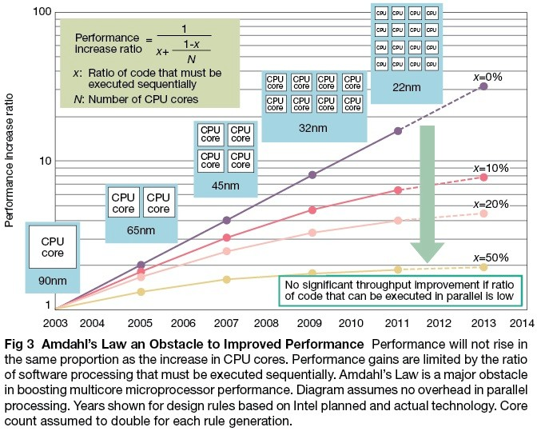
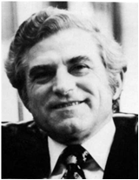
Caveat! Amdahl’s Law
Gene Amdahl
Computer Pioneer

Slide 36
Great Idea #5: Performance Measurement and Improvement
How hardware and software affect performance ?
Hardware or software component | How this component affects performance
Algorithm
Programming language, compiler, and architecture
Processor and memory system
I/O system (hardware and operating system )
Determines both the number of source level statements and the number of I/O operations executed
Determines the number of computer instructions for each source level statement
Determines how fast instructions can be executed
Determines how fast I/O operations may be executed

Slide 37
Great Idea #5: Performance Measurement and Improvement
Matching application to underlying hardware to exploit:
Locality
Parallelism
Special hardware features, like specialized instructions (e.g., matrix manipulation)
Latency/Throughput
How long to set the problem up and complete it (or how many tasks can be completed in given time)
How much faster does it execute once it gets going
Latency is all about time to finish

Slide 38
Great Idea #6: Dependability via Redundancy
Redundancy so that a failing piece doesn’t make the whole system fail
Applies to everything from datacenters to storage to memory to instructors
Redundant datacenters so that can lose 1 data center, but Internet service stays online
Redundant disks so that can lose 1 disk but not lose data (Redundant Arrays of Independent Disks/RAID)
Redundant memory bits of so that can lose 1 bit but no data (Error Correcting Code/ECC Memory)

Slide 39
Homework
Reading Technologies for Building Processors and Memory (Section 1.5 #page 24) and writing the report

